Slide 1

Clinical implications of mucus hypersecretion and mucus plugging in severe asthma and the potential role of epithelial cytokines​

Slide 2
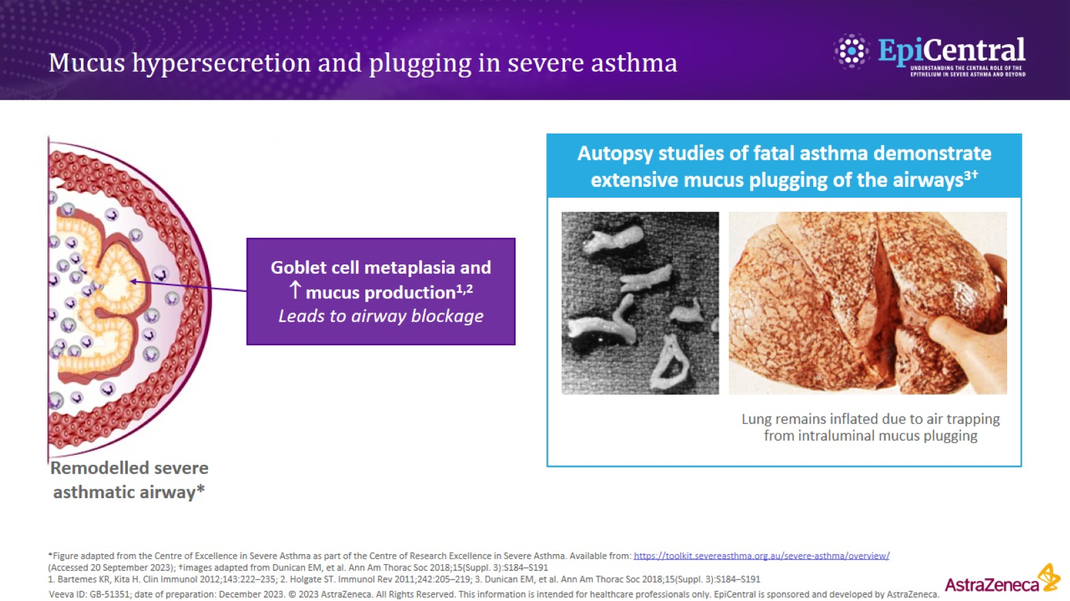
Mucus hypersecretion and plugging in severe asthma

Slide 3
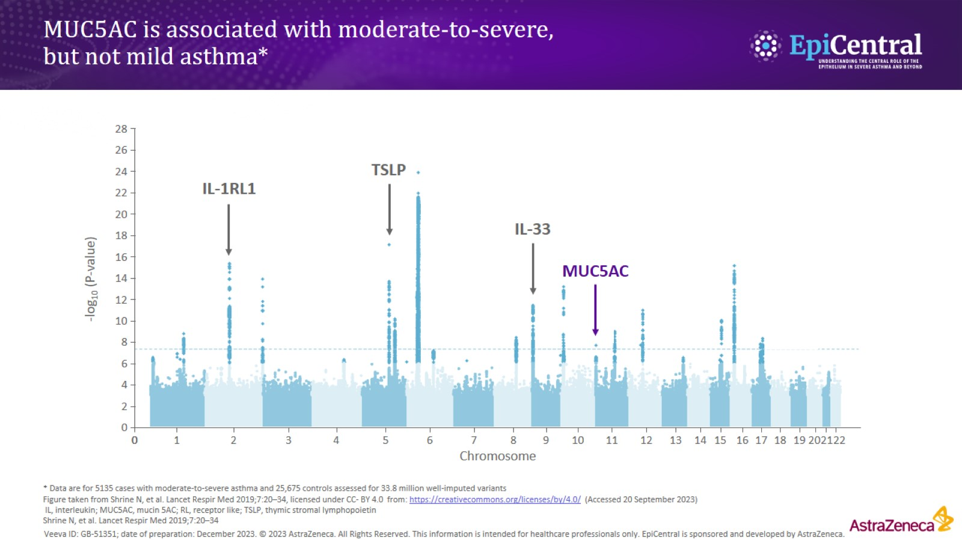
MUC5AC is associated with moderate-to-severe, but not mild asthma*

Slide 4
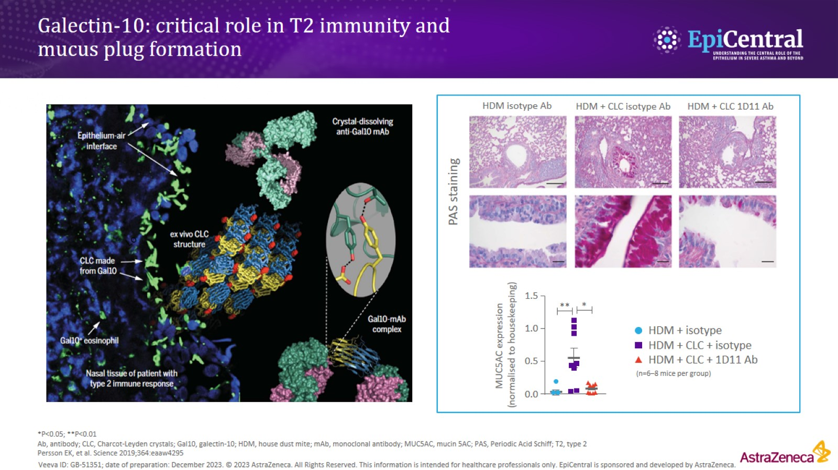
Galectin-10: critical role in T2 immunity and mucus plug formation

Slide 5
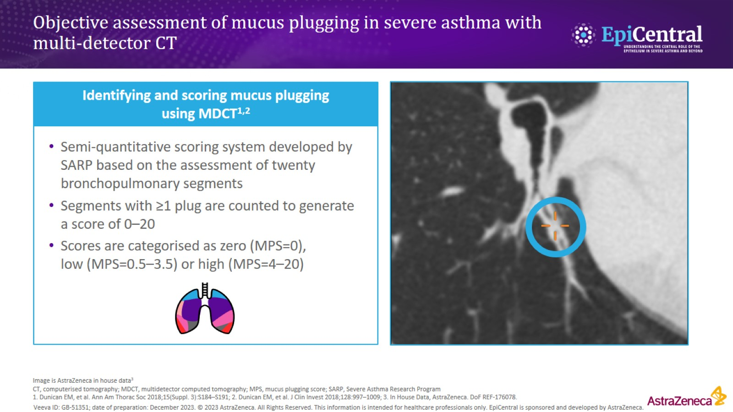
Objective assessment of mucus plugging in severe asthma with multi-detector CT

Slide 6
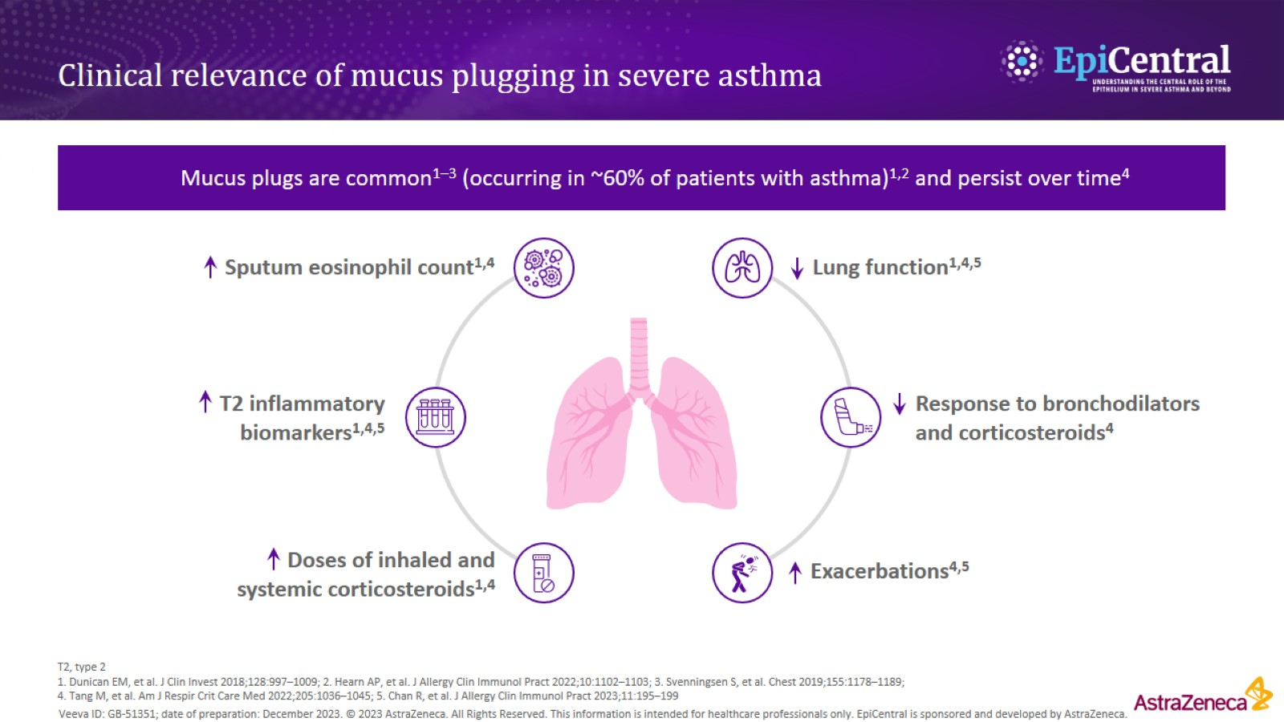
Clinical relevance of mucus plugging in severe asthma

Slide 7
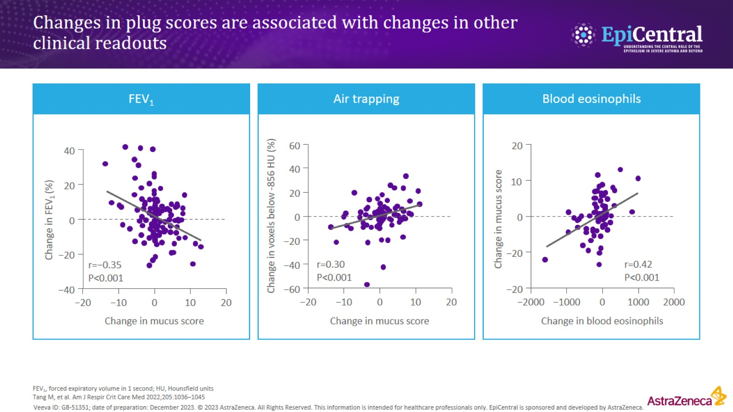
Changes in plug scores are associated with changes in other clinical readouts

Slide 8
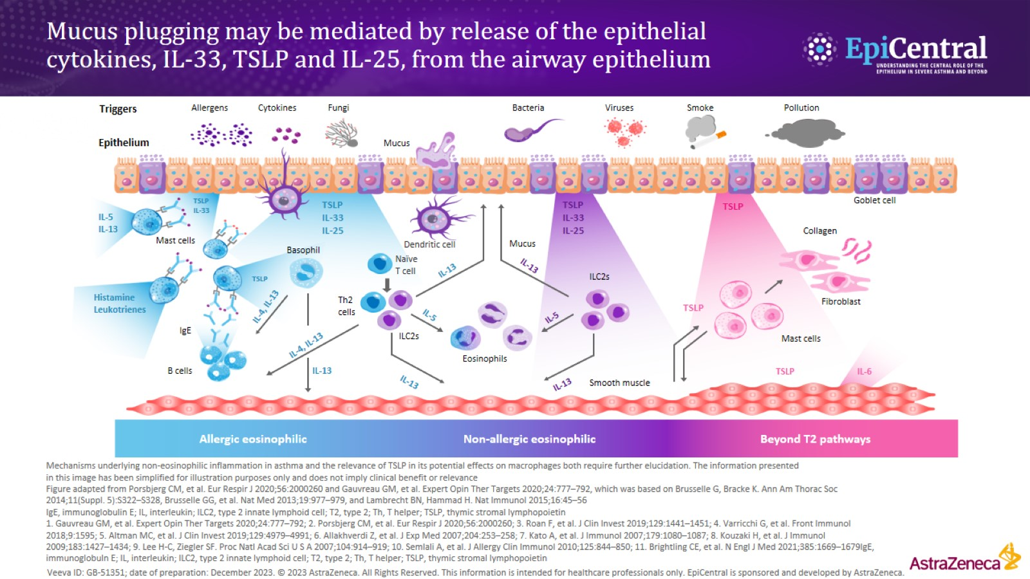
Mucus plugging may be mediated by release of the epithelial cytokines, IL-33, TSLP and IL-25, from the airway epithelium

Slide 9
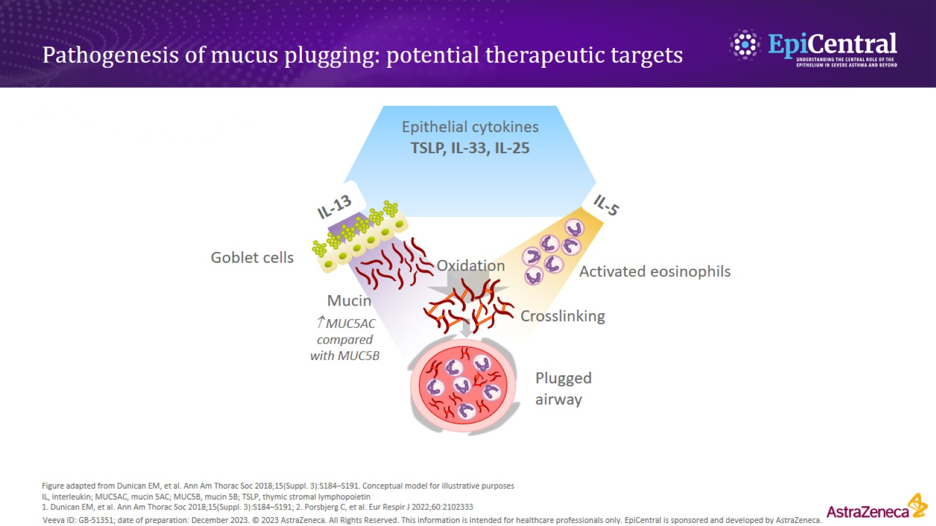
Pathogenesis of mucus plugging: potential therapeutic targets

Slide 10
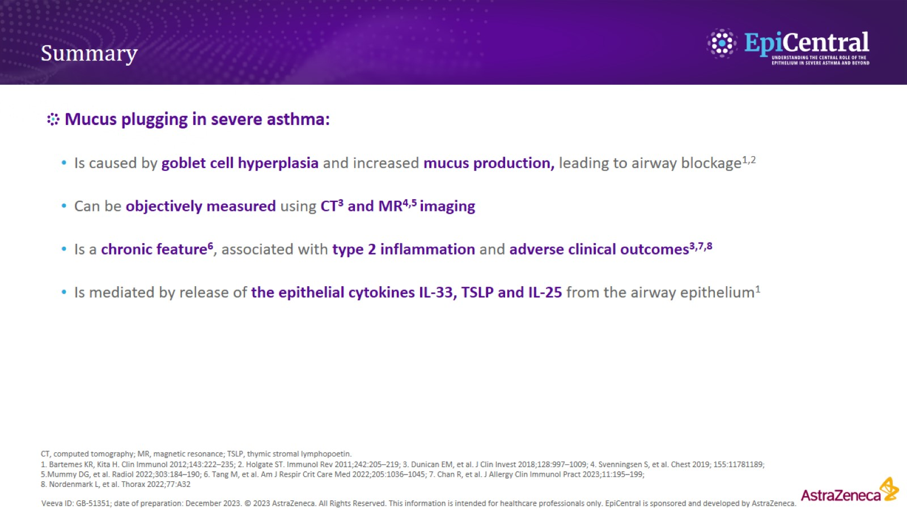
Summary

